Slide 1
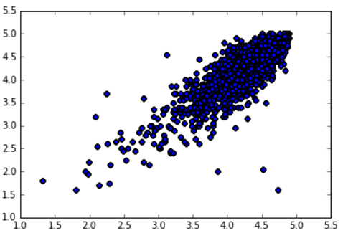
Mean of first 20 ratings
Mean of all ratings

Slide 2
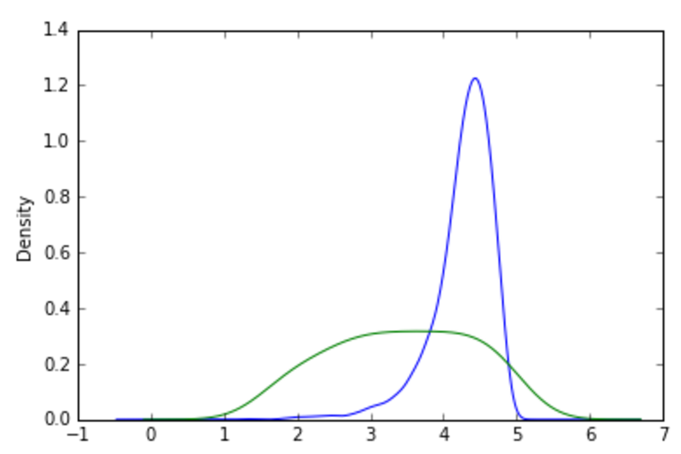
Kernel Density Estimate of Ratings
Overall Mean Rating
Mean of First 20 Ratings

